Slide 1
Red and White Wine Analysis
DAB - Data Analytics Boys
Atharva S Gadad | PES1UG20CS088
Aaditya Vikram | PES1UG20CS528
Dhruv Jyoti Garodia | PES1UG20CS527
Alan S Paul | PES1UG20CS624

Slide 2
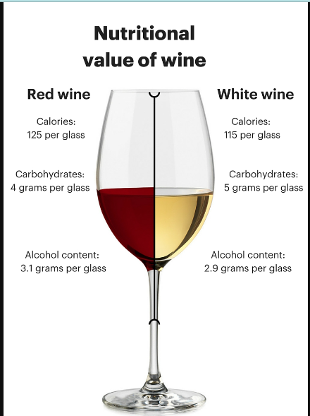
INTRODUCTION
Wine is an alcoholic drink that is made up of fermented grapes. Depending on the variety of grape used wine is available in two types: Red wine and White wine.
White wine is primarily made with white grapes, and the skins are separated from the juice before the fermentation process. Red wine is made with darker red or black grapes, and the skins remain on the grapes during the fermentation process.
Studies have shown that moderate wine consumption may be good for your heart and circulatory system. There is also evidence that drinking wine in moderation may lower your risk of type 2 diabetes.

Slide 3
DATASET USED
Link to download dataset: https://www.kaggle.com/code/danielpanizzo/red-and-white-wine-quality/data
Description:
The dataset used contains data about various chemical properties of wine, quality of wine and the type of wine(Red or white). The quality of wine was evaluated by three experts who provided score between 0(Bad) and 10(Excellent) for each wine.

Slide 4
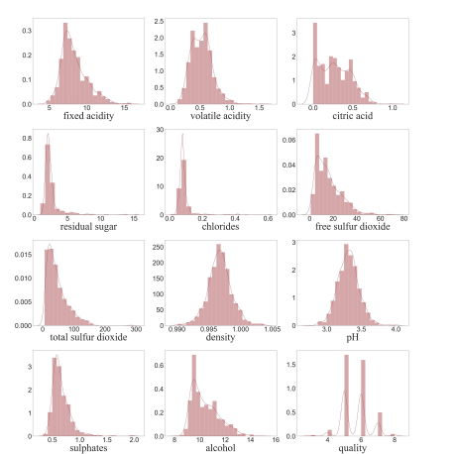
FEATURES PRESENT IN THE DATASET AND ANALYSIS
->During the process of fermentation some amount of sugar gets converted to alcohol. The remaining sugar content is residual sugar. Most of the residual sugar content is less than 4 g/l indicating that most of the alcohol in the dataset is dry in nature.
->Acids in wine are off two types - volatile acidity and fixed acidity. Volatile acidity influences the smell of wine and fixed acidity influences the taste.
->Citric acid is mainly used in cheap quality wines.
->PH is used for indicating acidity which in turn is a good indicator of taste as well

Slide 5
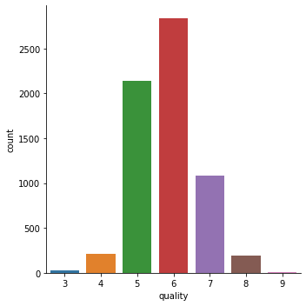
EDA ON WINE DATASET
Bar plot for the Quality column
We find that an average wine has a quality metric of 6

Slide 6
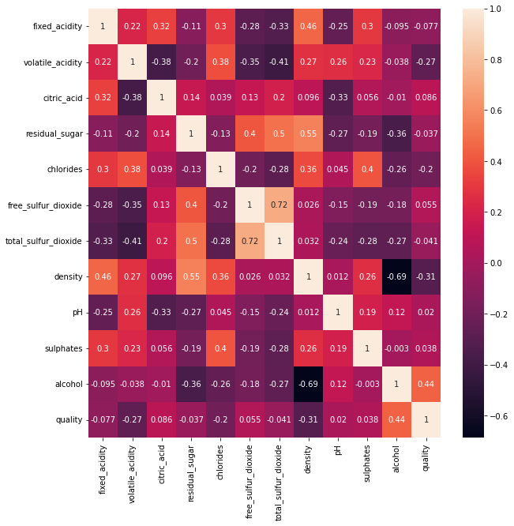
EDA ON WINE DATASET
Correlogram of wine dataset representing correlation between different features in the dataset

Slide 7
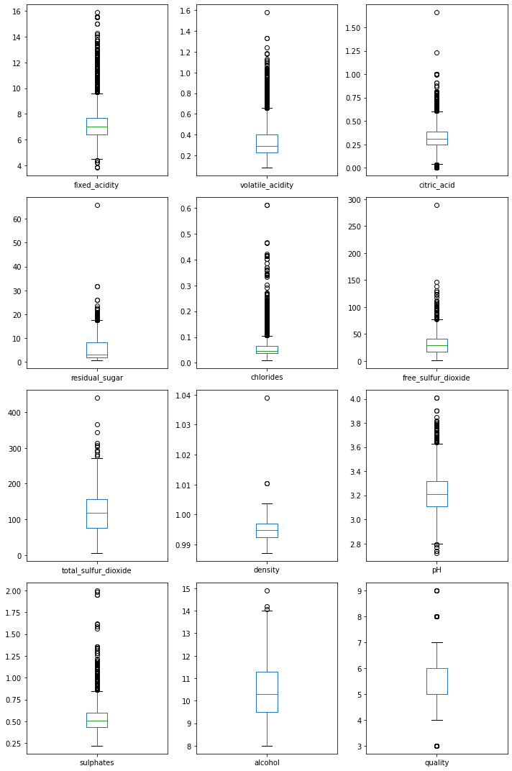
EDA ON WINE DATASET
Boxplot for all attributes of wine dataset.
We can observe that other than density and alcohol attributes “ remaining attributes have multiple outliers.

Slide 8
EDA ON WINE DATASET

Slide 9
Feature Selection
To analyze data we will reduce features to be used for analysis or else analyzing data will become computationally expensive and also the model might not perform well due to unnecessary variables which are not relevant to the target variable.
Correlation
Variance Threshold Based Selection
Mean Absolute Difference (MAD)
Information Gain
Random Forest based Selection
Backward Feature Selection
Forward Feature Elimination

Slide 10
Inference from Correlogram Plot
From the plot we see that total and free sulphur dioxide are highly correlated, so in our model prediction we are just using Total Sulphur Dioxide.
Similarly, for Alcohol and Density, we choose Density.
Highly
Correlated

Slide 11
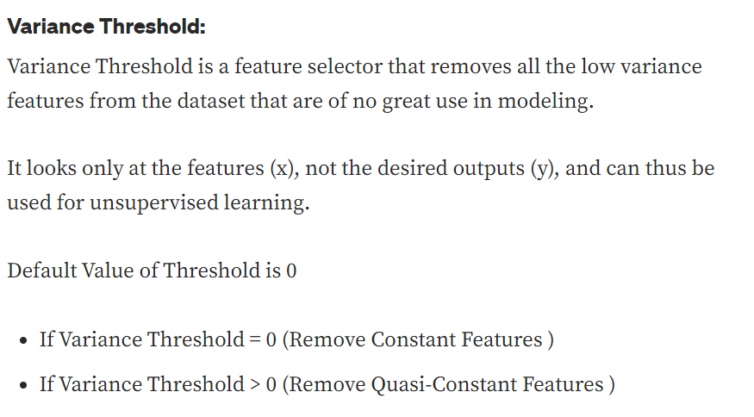
(2) Variance based feature Selection

Slide 12
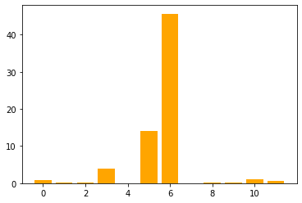
(3) Mean Absolute Difference (MAD)
'fixed acidity',
'volatile acidity',
'citric acid',
'residual sugar',
'Chlorides',
'free sulfur dioxide',
'total sulfur dioxide',
'Density',
'pH',
'Sulphates',
'Alcohol',
'quality'

Slide 13
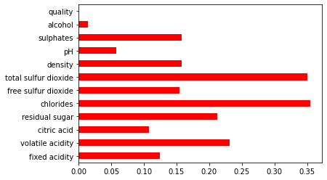
(4) Information Gain
'Chlorides',
'total sulfur dioxide',
'volatile acidity',
'residual sugar',
'Sulphates',
'Density',
'free sulfur dioxide',
'fixed acidity',
'citric acid',
'pH',
'Alcohol'

Slide 14
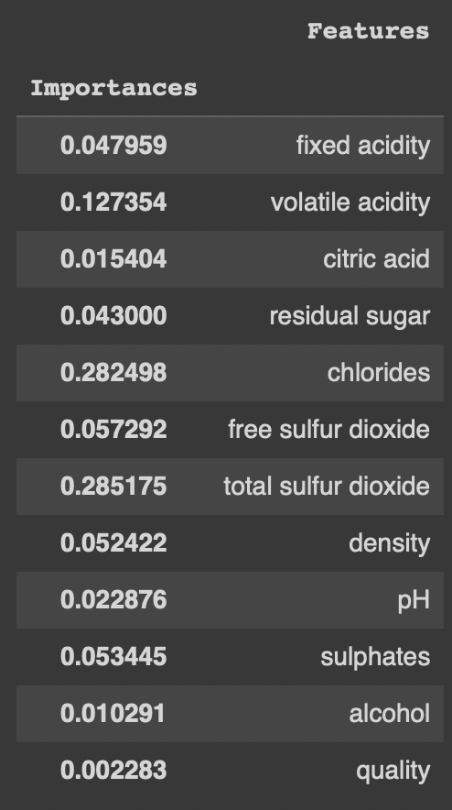
(5) Random Forest based Selection
Random forests consist of 4 –12 hundred decision trees, each of them built over a random extraction of the observations from the dataset and a random extraction of the features.
Not every tree sees all the features or all the observations, and this guarantees that the trees are de-correlated and therefore less prone to over-fitting.

Slide 15
Chosen Attributes
After applying feature selection technique these are the final list of features we will be using to train models we build.
Total Sulfur Dioxide
Chlorides
Volatile Acidity
Residual Sugar
Sulfates
Fixed Acidity

Slide 16
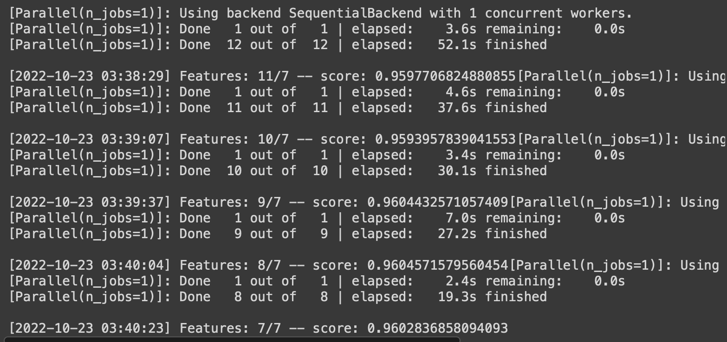
(6) Backward Feature Selection
'volatile acidity',
'residual sugar',
'chlorides',
'total sulfur dioxide',
'Density',
'pH',
'alcohol'

Slide 17
ANN TO CLASSIFY TYPE OF WINE
We constructed multiple artificial neural network models to classify the type of wine having different layers, optimizers and activation function. We recorded the accuracy for each model.
Type 1: 1 hidden layer having 128 neurons with relu function as activation function and output layer having sigmoid function as activation function. Adam optimizer used for the model. Test accuracy achieved is 97.61538505554199%.
Type 2: 4 hidden layers used having 64,128,128,256 hidden neurons respectively. The output layer has sigmoid activation function. Adam optimizer used. Test accuracy achieved is 97.76923060417175%.
Type 3: Same as Type 2 but it uses SGD as optimizer. Test accuracy achieved is :97.76923060417175%.
We can see that as we increased the number of layers the prediction
accuracy also increases.

Slide 18
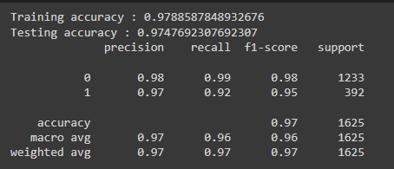
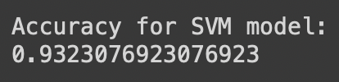
CLASSIFICATION OF WINE TYPE
Logistic Regression SVM
We created a SVM with rbf(Radial Basis Function) Kernel. We then fed the training data as well as expected type of wine to the model and trained it. After training the SVM model, the accuracy achieved was 0.9323076923076923%
It is statistical analysis method to predict binary outcome , such as Yes or No , based on the prior observations of the data set

Slide 19
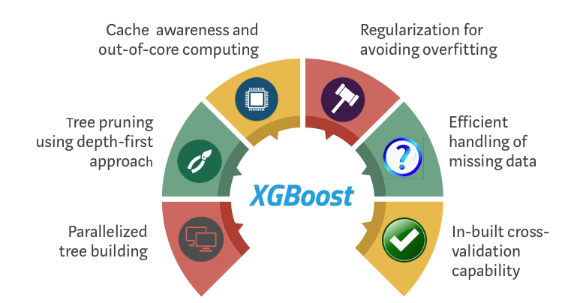
XGBoost
XGBoost is an implementation of Gradient Boosted decision trees. In this algorithm, decision trees are created in sequential form. Weights play an important role in XGBoost.
Weights are assigned to all the independent variables which are then fed into the decision tree which predicts results. The weight of variables predicted wrong by the tree is increased and these variables are then fed to the second decision tree.
These individual classifiers/predictors then ensemble to give a strong and more precise model. It can work on regression, classification, ranking, and user-defined prediction problems.

Slide 20

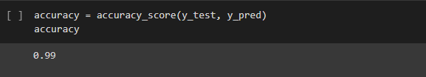
XGBoost CLASSIFIER TO CLASSIFY TYPE OF WINE
We fed both input data and expected output data to the Classifier to train the model and computed the accuracy over testing data. The accuracy that was achieved is 99%

Slide 21

Thanks from team
DAB

